Slide 1
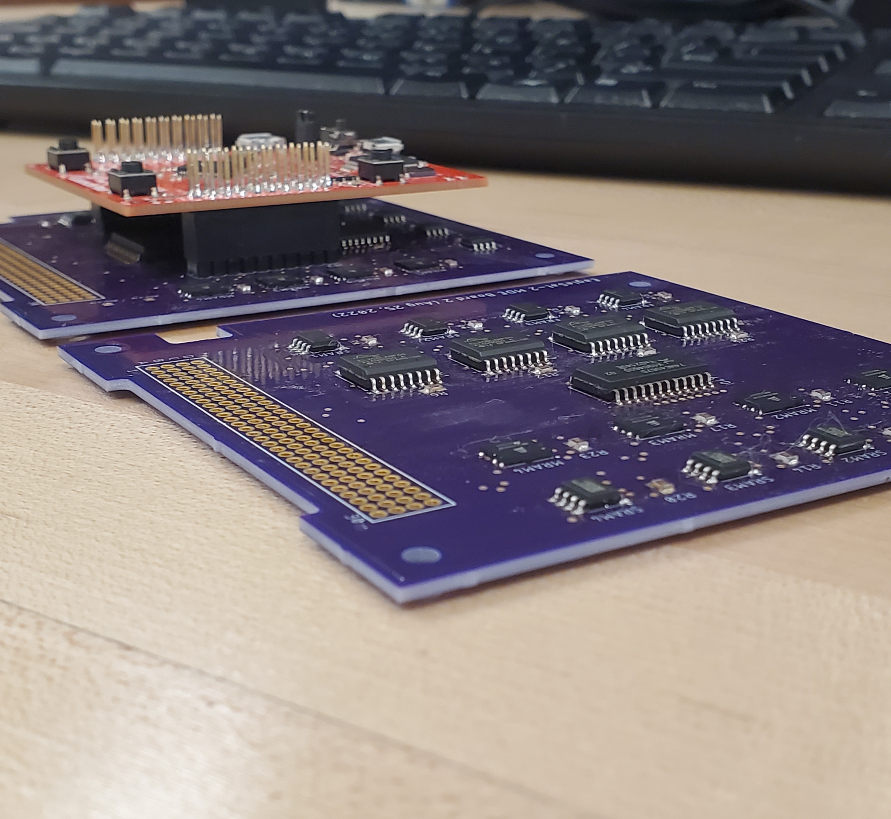


EagleSat-2: Memory Degradation Experiment
Calvin Henggeler & Tyler Thurman
Mentor: Dr. Ahmed Sulyman
Embry-Riddle Aeronautical University, Dept of Computer, Electrical, and Software Engineering

Slide 2
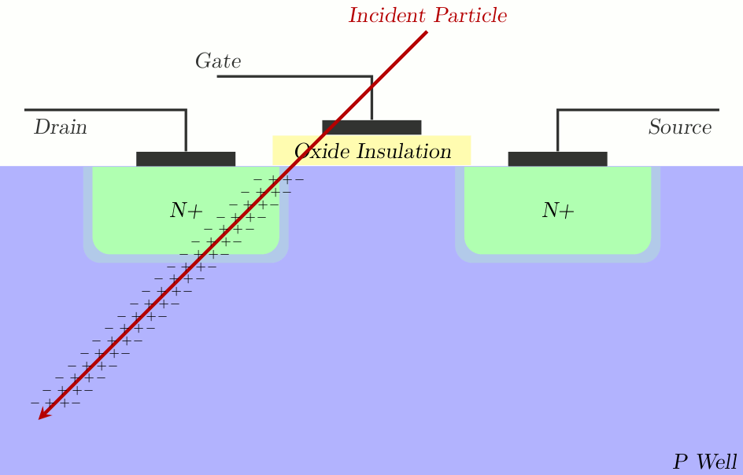
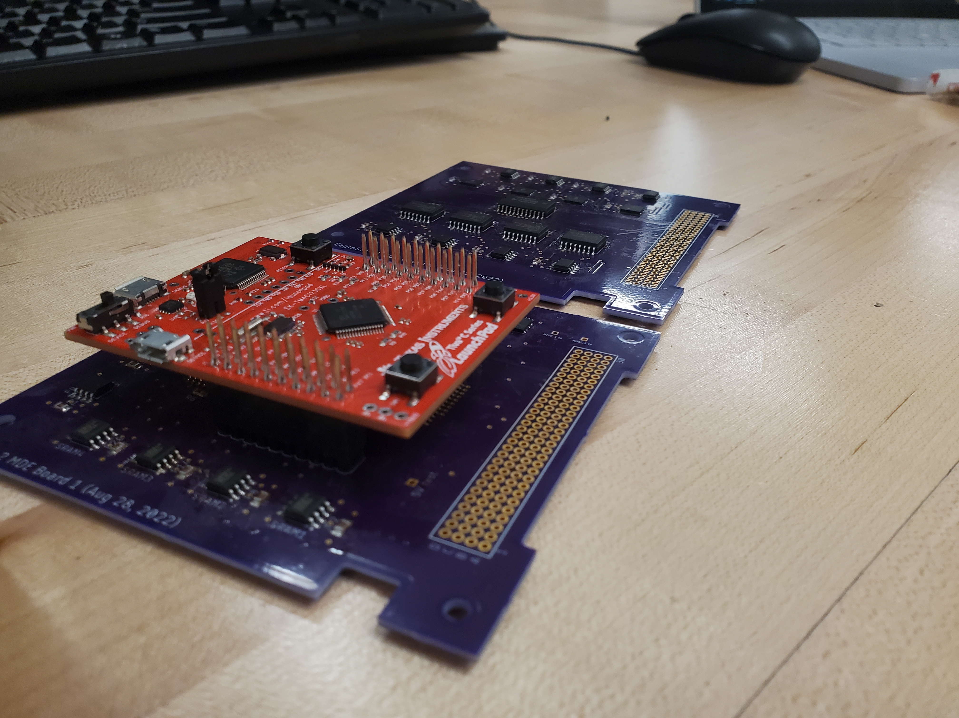
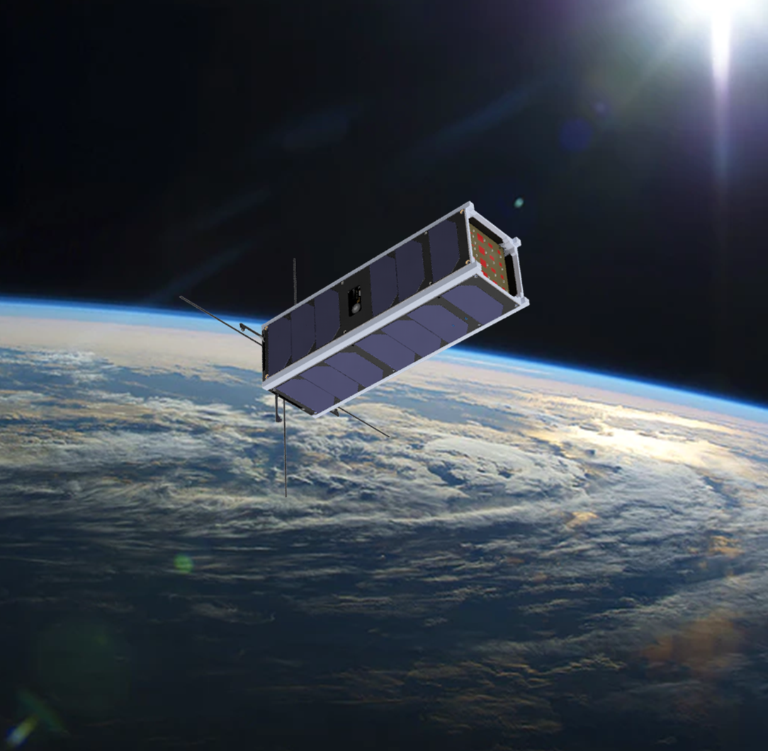
What is MDE?
Primary payload of EagleSat-2
Tests degradation of computer memory by Single Event Upsets (SEU, “bit-flip”)
Compares 4 Different Memory Types
FLASH, FRAM, MRAM, SRAM
Undergraduate designed and developed
Notes:
MDE tests the degradation of Computer memory in Low Earth Orbit LEO against exposure to solar radiation
SEU is caused by charged particles colliding with individual memory cells and disrupting the charge held possibly altering the state
Simultaneously test 4 different memory types: FLASH, FRAM, MRAM, SRAM
Completely undergraduate designed and developed

Slide 3
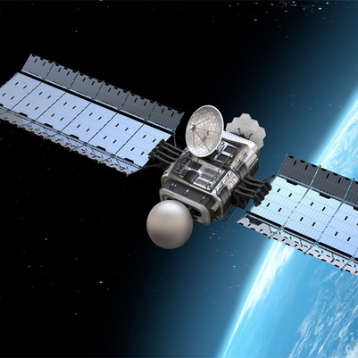
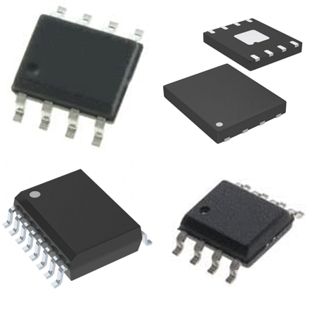
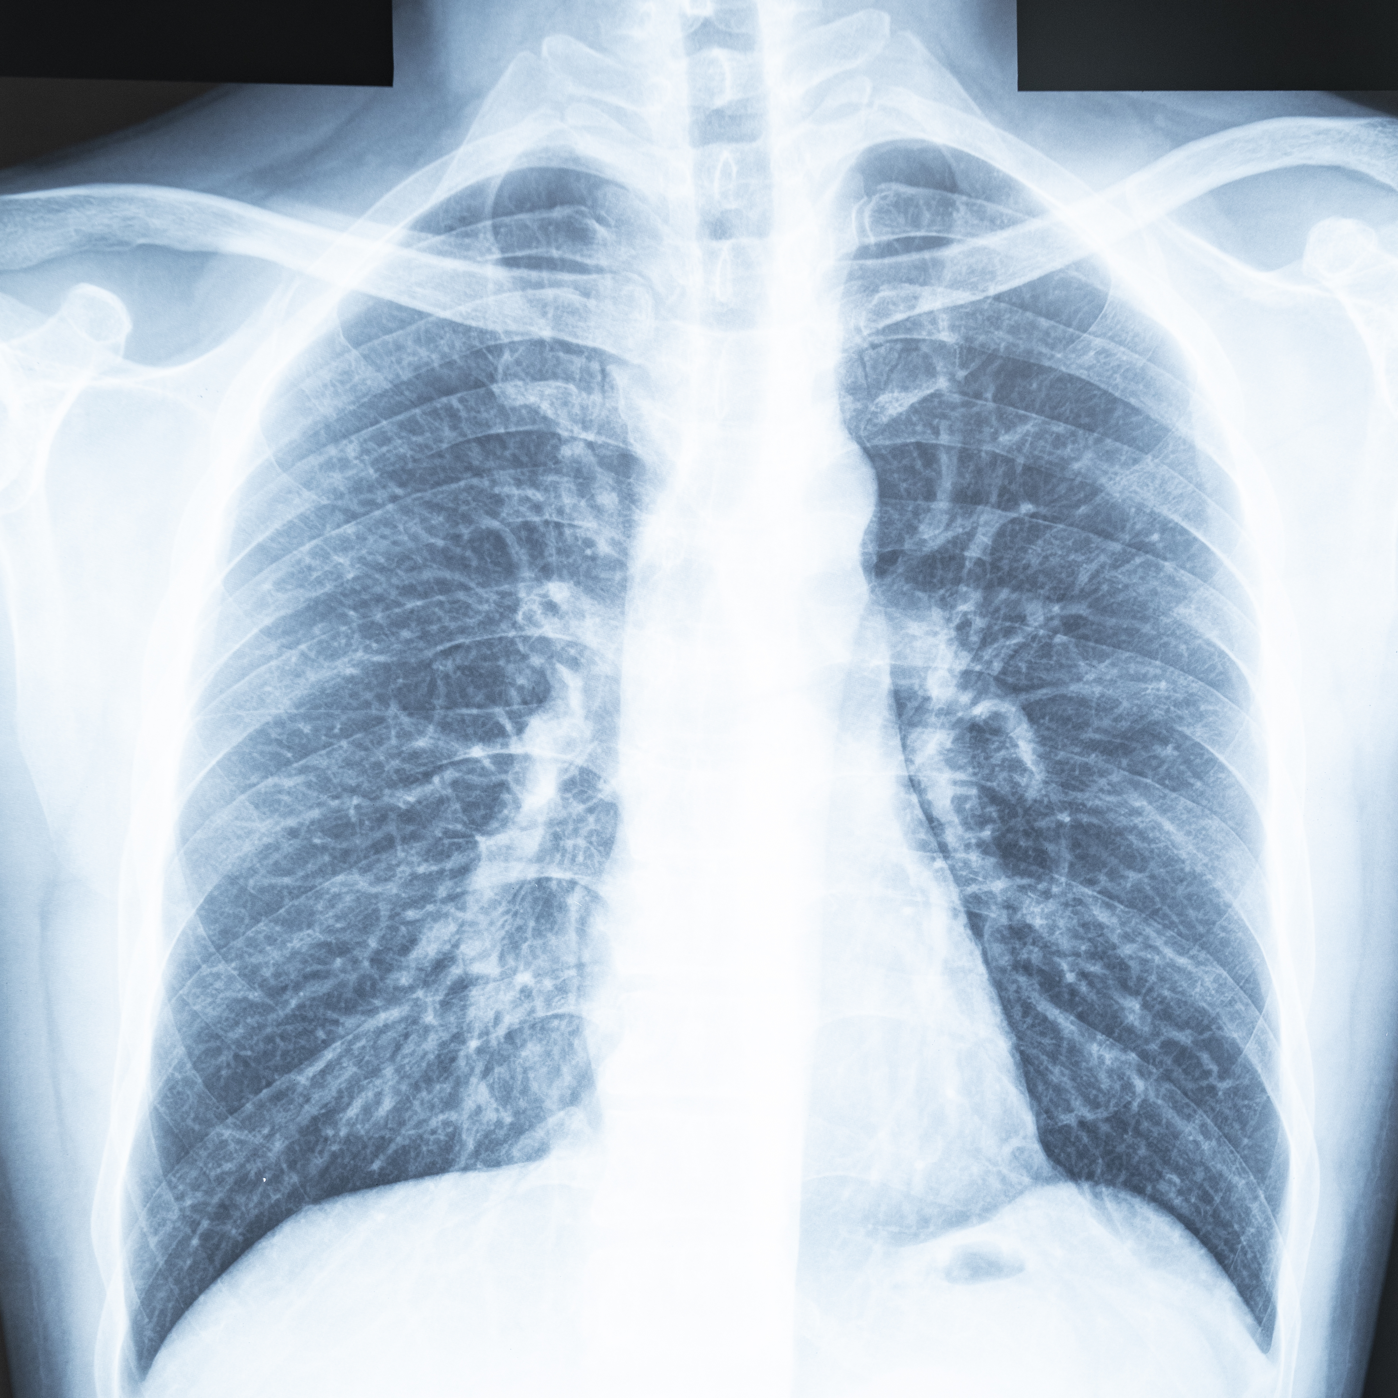
Why MDE Matters
Field Experiment
Direct comparison of memory types
All off-the-self components
Data relevant to all radiation prone environments
Unshielded memory behavior
Images from:
mouser.com,
baesystems.com,
PowerPoint stock image
Notes:
A direct comparison of mems with all other with no system dependencies
Memory not a factor of the experiment, it is the experiment.
Off the shelf components (mouser or Digikey)
Collected data relevant to all radiation prone environments
Nuclear Energy, Medical applications, Space
Memory modules unshielded, raw behavior compared across devices.

Slide 4
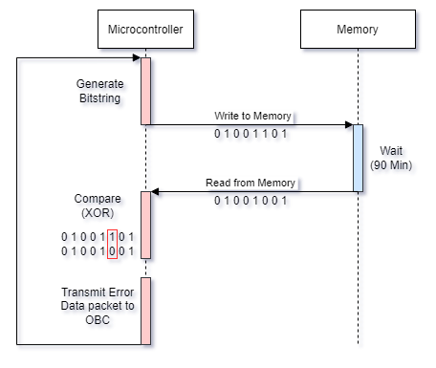
Experiment Flowchart
Notes:
Functional experiment loop

Slide 5
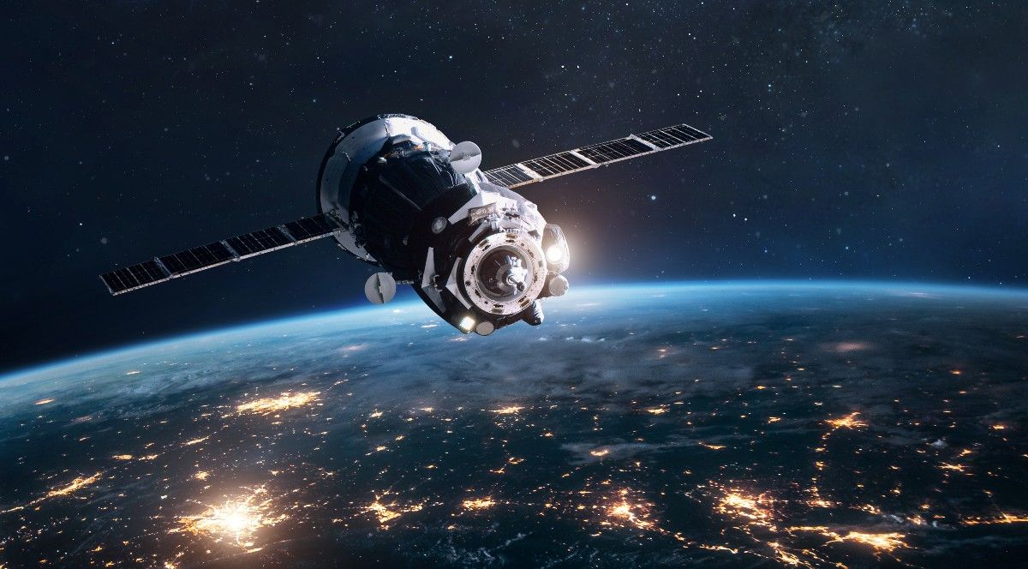
What we hope to learn
Memory Reliability for LEO Environment
radiation effects on unshielded Memory
ERROR Mitigation & detection techniques
01001001 00100000 01100001 01101101 00100000 01000011 01100001 01101100 01110110 01101001 01101110 00100000 01001000 01100101 01101110 01100111 01100111 01100101 01101100 01100101 01110010 00100000 01100110 01110010 01101111 01101101 00100000 01001101 01000100 01000101 00100001 00100011
space.com
cogenda.com
Notes:
Form the MDE we want to learn:
The performance and limitations of different memory types used in the LEO environment
This also becomes relevant to other radiation relevant fields
Possibility of “hard errors”
We want to learn more about the effects that radiation has on memory by analyzing the occurrences of SEU’s,
Where in memory, when, what type and the frequency of occurrence
Solar flare? Lots of data or a French-fried satellite?
Also want to learn any mitigation, detection, or recovery techniques form analyzing the data and looking for any patterns?

Slide 6
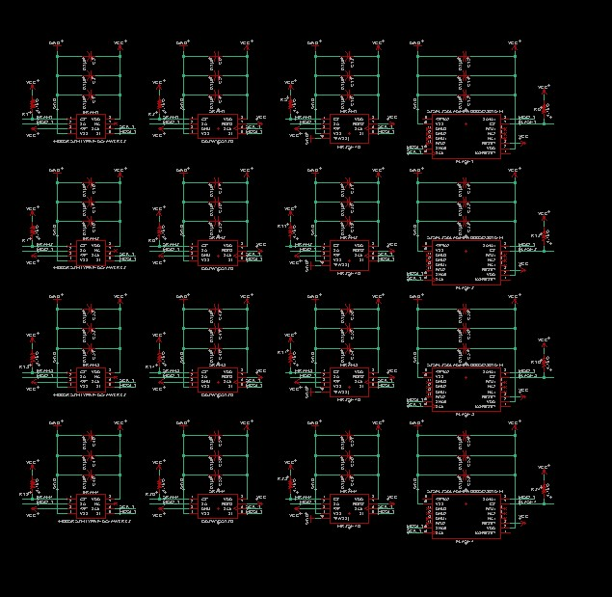
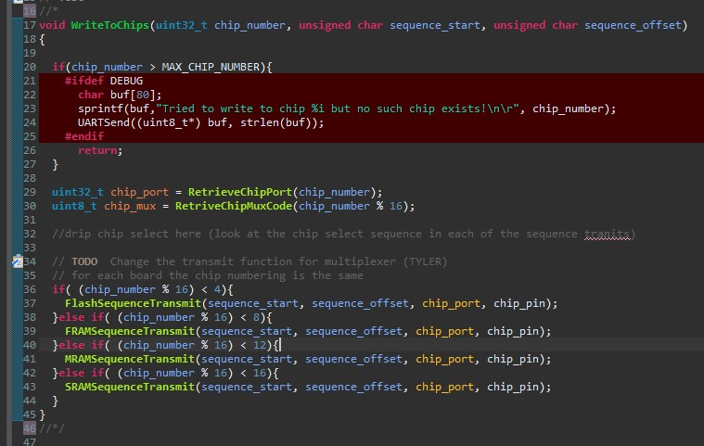
Apparatus

Slide 7
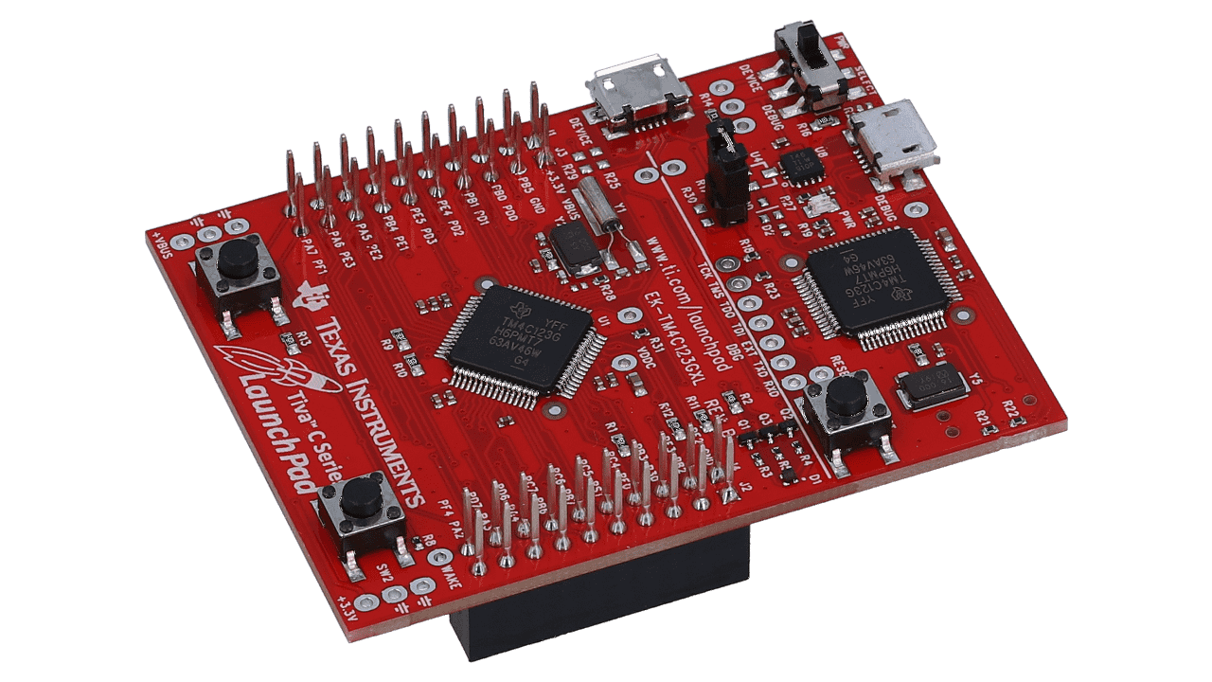
Texas Instruments EK-TM4C123GXL
TM4C123GH6PM microcontroller
TI TivaWare for C Series SDK
Ability to develop externally
Small (5.08cm x 6.60cm x 1.76cm)
Cheap (~$16.99)
Ample Support
Notes:
The EK-TM4C was chosen because it met all of our needed character that we needed to be able to run the experiment
On board microcontroller host all needed peripherals to run the experiment (SPI, Timers, GPIO), and to devep a debug/development interface (UART, USB 2.0 Virtual Com port)
Able to program with TivaWare SDK. Plat form we are comfortable with from Microprocessors class (directly transferable skill)
Not embedded into PCB, can develop externally from other hardware, then plug and play
Small and Cheap
Great support network of provided examples, forums, and documentation

Slide 8

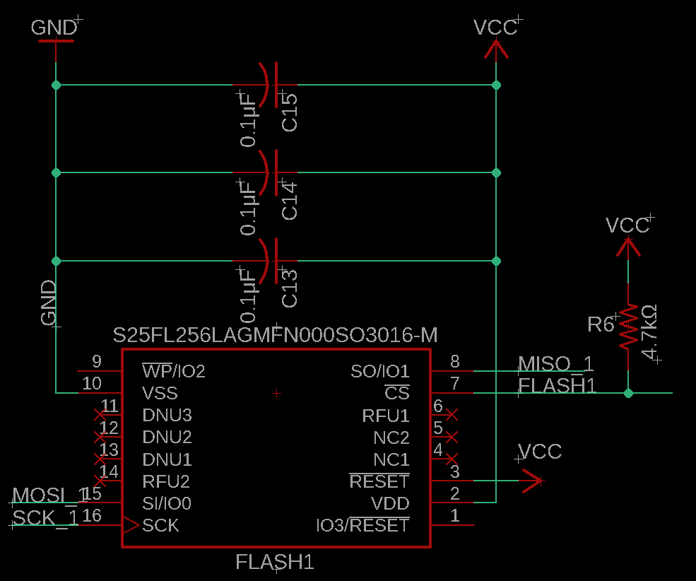
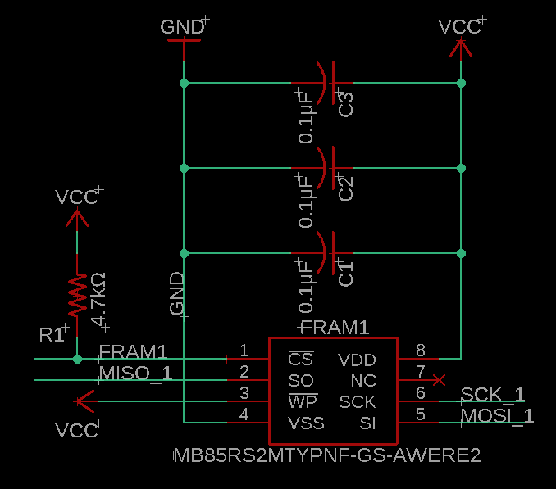
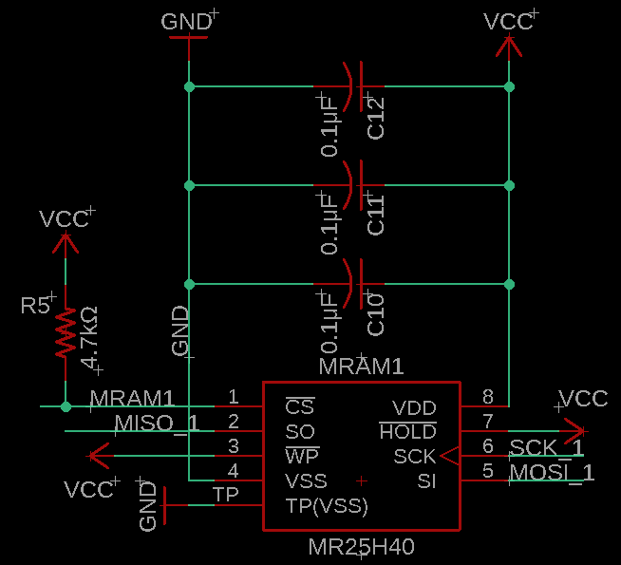
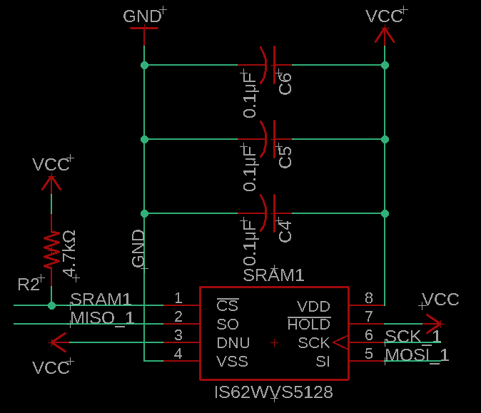

Memory Types
Flash
F-RAM
M-RAM
S-RAM
NOR architecture
Cypress S25FL256LAGMFN000
Non-volatile
256Mbit
$7.26 Unit Price
Ferroelectric RAM
Fujitsu MB85RS2MTYPNF
Non-volatile
2 Mbit
$8.06 Unit price
Magnetoresistive RAM
Everspin Technologies MR25H40CDF
Non-volatile
4Mbit
$21.02 Unit price
Static RAM
ISSI IS62WVS5128GBLL
Volatile
4Mbit
$5.53 Unit price

Slide 9
Performance Factors and Expectations
Memory Type | Tolerance | Other Factors | Expected Behavior
Flash | Med-High | Non-Volatile Auto Temp Tolerance | Few errors
FRAM | High | Non-Volatile Industrial Temp Tolerance | None to few errors
MRAM | Immune | Non-Volatile Industrial Temp Tolerance | None
SRAM | Low | Volatile Industrial Temp Tolerance | Many, total data loss upon restart
Notes:
On a qualitative level

Slide 10

Summary
Using off the shelf components to test the reliability and competence of computer memory against solar radiation in Low Earth Orbit.

Slide 11
Thank You
Calvin Henggeler – Henggelc@my.erau.edu
Tyler Thurman – Thurmant@my.erau.edu

Slide 12
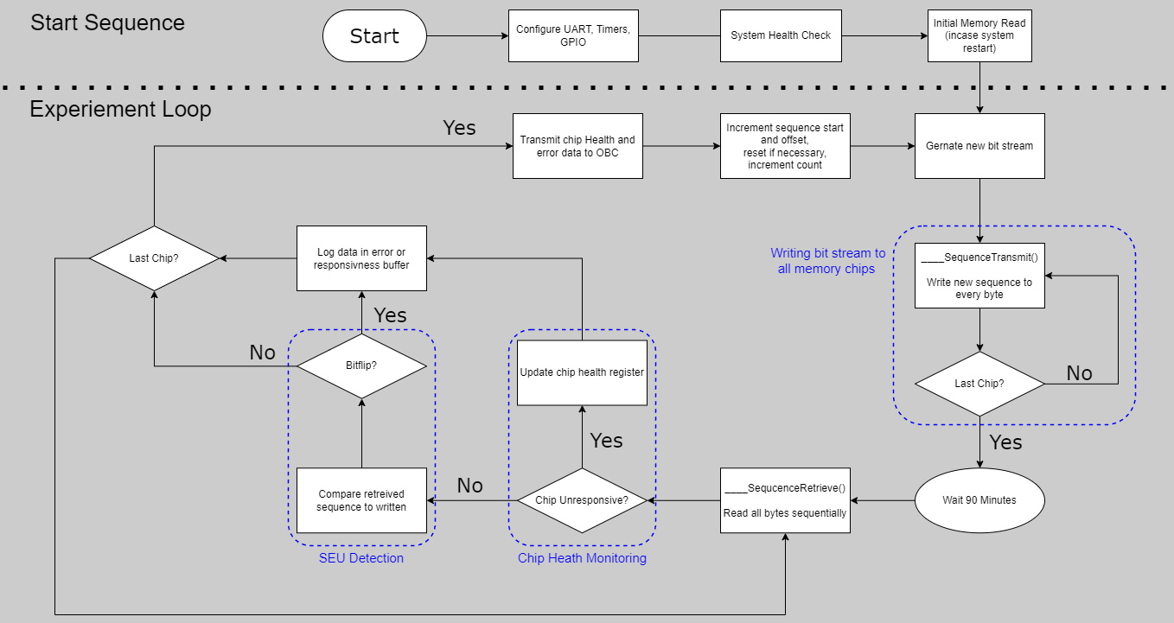
System Flowchart

Slide 13
Timeline
Develop
(Now-Aug) Continue to develop payload hardware and software.
(Aug-Oct)Test MDE in full stack. Final debugging. Forced error analysis
Deliver & Launch
TBD, Battery still on “vacation”
Collect
Analyze
Data is analyzed and conclusions drawn and elaborated
MDE collects SEU data and transmits to ground
Test

Slide 14



Team
Calvin Henggeler
Tyler Thurman
Payload Design Lead
B.S. Computer Engineering ’24
Henggelc@my.erau.edu
Payload Engineer
B.S. Computer Engineering ’24
Thurmant@my.erau.edu

